Slide 1

Classification & Logistic Regression & maybe deep learning
?
Slides by:
Joseph E. Gonzalez jegonzal@cs.berkeley.edu

Slide 2
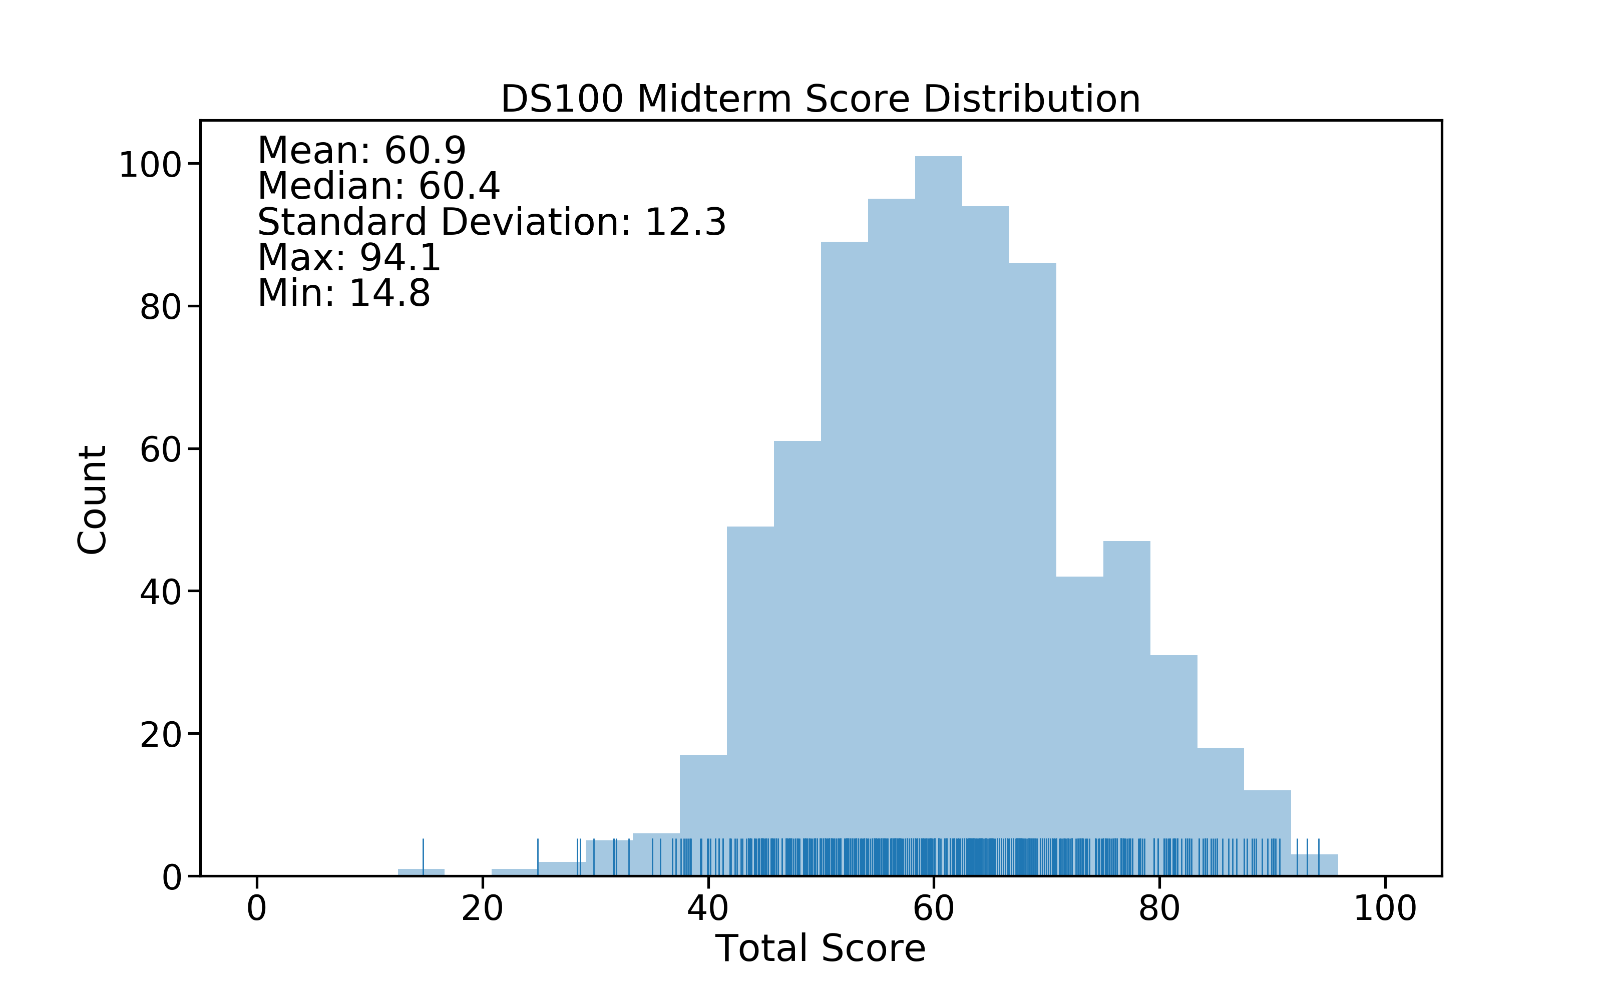

Slide 3
Previously…

Slide 4
Classification
Domain
isAlive?
{0,1}
Squared Loss
Regularization

Slide 5
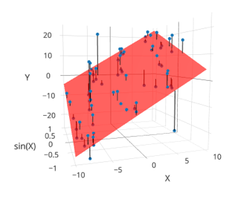
Taxonomy of Machine Learning
Labeled Data
Reward
Unlabeled Data
Supervised Learning
Reinforcement
Learning
(not covered)
Unsupervised
Learning
Quantitative Response
Categorical Response
Dimensionality Reduction
Clustering
Regression
Classification
Alpha Go

Slide 6
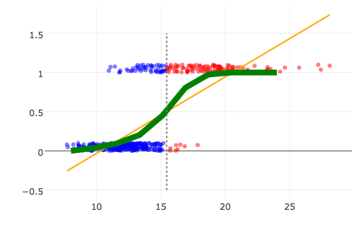
Classification
Domain
isCat?
{0,1}
Can we just use least squares?

Slide 7
Defining a New Model for Classification

Slide 8
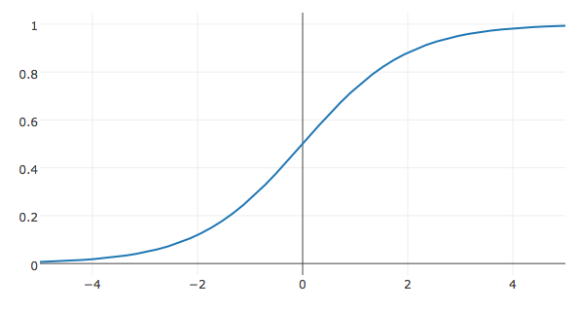
Logistic Regression
Model the probability of a particular label:
Linear Model

Slide 9
Motivation for the Logistic Model
Model the “log odds” as a linear model
Linear Model
Log odds

Slide 10
Motivation for the Logistic Model
Taking the exponent of both sides

Slide 11
Motivation for the Logistic Model
Taking the exponent of both sides
Algebra
Expanding terms
Collect terms on the other side …
Solving for P(y=1|x)
Notes:
A / (1-A) = b
A = b - bA
A(1 +b) = b
A = b/ (1+b)

Slide 12
Motivation for the Logistic Model
Taking the exponent of both sides
Algebra
Expanding terms
Collect terms on the other side …
Solving for P(y=1|x)
Dividing numerator and denominator by exp(𝜙(x_{i})^{T}θ)
Where
Notes:
A / (1-A) = b
A = b - bA
A(1 +b) = b
A = b/ (1+b)

Slide 13
The Logistic Regression Model
Model:
How do we fit the model to the data?

Slide 14
Defining the Loss

Slide 15
Could we use the Squared Loss
What about squared loss and the new model:
Tries to match probability with 0/1 labels.
Occasionally used in some neural network applications
Non-convex!

Slide 16
Could we use the Squared Loss
What about squared loss and the new model:
Tries to match probability with 0/1 labels.
Occasionally used in some neural network applications
Non-convex!
Toy data
Squared Loss Surface

Slide 17
Defining the Cross Entropy Loss

Slide 18
Loss Function
We want our model to be close to the data:
Example: (cute or not)?
 | Cute | Not Cute
Observed Probability | = 1.0 | = 0.0
Predicted Probability | = 0.8 | = 0.2
x =
y = 1 “cute"

Slide 19
Loss Function
We want our model to be close to the data:
Kullback–Leibler (KL) Divergence provides a measure of difference between two distributions:
Difference between two discrete distributions P and Q

Slide 20
Kullback–Leibler (KL) Divergence
P Distribution
The average log difference between P and Q weighted by P
Does not penalize mismatch for rare events with respect to P
Note that it is not symmetric
Q Distribution

Slide 21
Loss Function
We want our model to be close to the data:
Kullback–Leibler (KL) divergence for classification
For a single (x,y) data point
Average KL Divergence for all the data:
=2
Binary Classification

Slide 22
Loss Function
We want our model to be close to the data:
Kullback–Leibler (KL) divergence for classification
For a single (x,y) data point
Average KL Divergence for all the data:
=2
Binary Classification
Log(a/b) = Log(a) – Log(b)
Doesn’t depend on θ

Slide 23
Loss Function
We want our model to be close to the data:
Kullback–Leibler (KL) divergence for classification
For a single (x,y)
Average cross entropy loss
Summing from k = 0 to 1 and not k = 1 to 2 (to be consistent with 0/1 labels):

Slide 24
Loss Function
We want our model to be close to the data:
Kullback–Leibler (KL) divergence for classification
For a single (x,y)
Average cross entropy loss
=2
Binary Classification
Rewriting on one line:

Slide 25
Loss Function
We want our model to be close to the data:
Kullback–Leibler (KL) divergence for classification
For a single (x,y)
Average cross entropy loss
Expanding
Grouping Terms
Copy & Paste

Slide 26
Definition
Alg.
Alg.
Alg.

Slide 27
Definition
A Linear model of the “Log odds”
Linear Model
Log odds

Slide 28
Definition
A Linear mode of the “Log odds”
Linear Model
Log odds
Implications?

Slide 29
A Linear mode of the “Log odds”
Linear Model
Definition
Log odds
Substituting the above result:
Defn. of σ
Alg.
Alg.

Slide 30
Substituting the above result:
Defn. of σ
Alg.
Alg.
Definition
Defn. of σ
Simplified Loss Minimization Problem

Slide 31
The Loss for Logistic Regression
Average cross entropy (simplified):
But After all that algebra…
Rewind for a minute to our probabilistic form of the average cross-entropy loss, so we can zoom in for intuition

Slide 32
Loss Function
We want our model to be close to the data:
Example: (cute or not)?
 | Cute | Not Cute
Observed Probability | = 1.0 | = 0.0
Predicted Probability | = 0.8 | = 0.2
x =
y = 1 “cute"

Slide 33
Average cross entropy loss
 | Cute | Not Cute
Observed Probability
Predicted Probability
Cross Ent.
Cute Cat Example
x =
, y = 1 “cute"
= 1.0
= 0.0
= 0.8
= 0.2
-1.0 Log(0.8)
≈ 0.22
-0.0 Log(0.2)
= 0.0
Also called the log loss because it is the log of the predicted probability for the true class

Slide 34
Loss Function
We want our model to be close to the data:
Kullback–Leibler (KL) divergence for classification
For a single (x,y)
Average cross entropy loss
 | Cute | Not Cute
Observed Probability
Predicted Probability
Cross Ent.
Cute Cat Example
x =
, y = 0 “not cute"
= 0.0
= 1.0
= 0.7
= 0.3
-0.0 Log(0.7)
= 0.0
-1.0 Log(0.3)
≈ 1.20
Also called the log loss because it is the log of the predicted probability for the true class

Slide 35
The Loss for Logistic Regression
Average cross entropy (simplified):
Equivalent to (derived from) minimizing the KL divergence
Also equivalent to maximizing the log-likelihood of the data … (not covered in DS100 this semester)
Is this loss function reasonable?

Slide 36
Convexity Using Pictures
Toy data
Squared Loss Surface
KL Div. Loss Surface

Slide 37
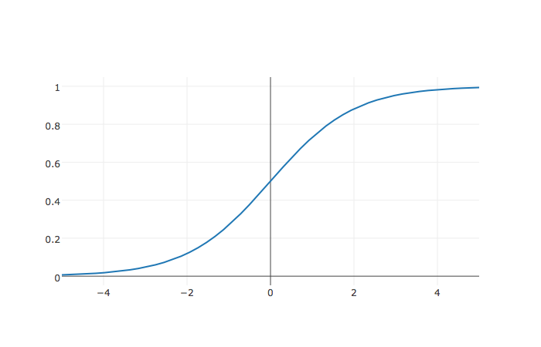
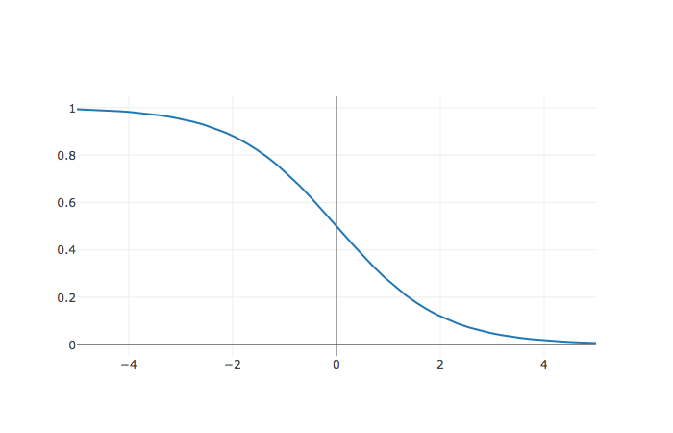
What is the value of θ?
http://bit.ly/ds100-fa18-???
Assume:
The Data
(-1,1)
1
(1,0)
-1
0
1

Slide 38
What is the value of θ?
Assume:
The Data
(-1,1)
1
(1,0)
-1
0
1

Slide 39
What is the value of θ?
(-1,1)
Assume:
The Data
1
For the point (-1,1):
(1,0)
Objective:
-1
0
1

Slide 40
What is the value of θ?
For the point (-1,1):
Assume:
For the point (1, 0):
(-1,1)
The Data
1
(1,0)
-1
0
1

Slide 41
What is the value of θ?
For the point (-1,1):
Assume:
Total Loss
For the point (1, 0):
Overly confident!
(-1,1)
1
Degenerate Solution!
The Data
(1,0)
-1
0
1

Slide 42
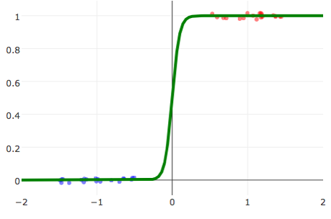
Linearly Separable Data
Linearly Separable Data
A classification dataset is said to be linearly separable if there exists a hyperplane that separates the two classes.
If data is linearly separable, logistic regression requires regularization
Not Linearly Separable Data
Weights go to infinity!
Solution?

Slide 43
Adding Regularization to Logistic Regression
Prevents weights from diverging on linearly separable data
Without Regularization
With Regularization (λ = 0.1)
Earlier Example

Slide 44
Minimize the Loss

Slide 45
Logistic Loss Function
Average KL divergence (simplified)
Take Derivative:

Slide 46
Logistic Loss Function
Average KL divergence (simplified)
Take Derivative:

Slide 47
Logistic Loss Function
Average KL divergence (simplified)
Take Derivative:
Useful Identity
Chain Rule
Chain Rule
Alg.
Defn. of σ
Alg.

Slide 48
Logistic Loss Function
Average KL divergence (simplified)
Take Derivative:
Useful Identity

Slide 49
Logistic Loss Function
Average KL divergence (simplified)
Take Derivative:
Set derivative = 0 and solve for θ
No general analytic solution
Solved using numeric methods

Slide 50
The Gradient Descent Algorithm
initial vector (random, zeros …)
For 𝜏 from 0 to convergence:
Evaluated
at
ρ(𝜏) is the step size (learning rate)
typically 1/𝜏
Converges when gradient is ≈ 0 (or we run out of patience)

Slide 51
Gradient Descent for Logistic Regression
Logistic Regression
initial vector (random, zeros …)
For 𝜏 from 0 to convergence:
ρ(𝜏) is the step size (learning rate)
typically 1/𝜏
Converges when gradient is ≈ 0 (or we run out of patience)
Notes:
= -\frac{1}{n}\sum_{i=1}^n \left(y_i
-\sigma\left(\phi(x_i)^T\theta\right) \right) \phi(x_i)

Slide 52
Stochastic Gradient Descent
For many learning problems the gradient is a sum:
For large n this can be costly
What if we approximated the gradient by looking at a few random points:

Slide 53
Stochastic Gradient Descent
For many learning problems the gradient is a sum:
For large n this can be costly
What if we approximated the gradient by looking at a few random points:
Batch
Size
Random sample of records
This is a reasonable estimator for the gradient
Unbiased …
Often batch size is one! (why is this helpful)
Fast to compute!
A key ingredient in the recent success of deep learning

Slide 54
Stochastic Gradient Descent
initial vector (random, zeros …)
For 𝜏 from 0 to convergence:
Decomposable
Loss
Loss can be written as a sum of the loss on each record.

Slide 55
initial vector (random, zeros …)
For 𝜏 from 0 to convergence:
Gradient Descent
Very Similar Algorithms
initial vector (random, zeros …)
Assuming Decomposable Loss Functions
For 𝜏 from 0 to convergence:
Stochastic Gradient Descent

Slide 56
Gradient Descent

Slide 57
Stochastic Gradient Descent

Slide 58
Logistic Regression in Scikit Learn
from sklearn.linear_model import LogisticRegression
# By default SK learn adds regularization # C = 1/lambda the inverse regularization parameter.
model = LogisticRegression(C=100.00)
# Train the model
model.fit(df[[‘feat1’, ‘feat2’]], df[‘label’])
# Make Predictions
test_df[‘label’] = model.predict(test_df[[‘feat1’, ‘feat2’]])
test_df[‘P(Y|X)’] = model.predict_proba(test_df[[‘feat1’, ‘feat2’]])

Slide 59
Python Demo!

Slide 60
Attendance Quiz
http://bit.ly/ds100-sp18-sgd
Is the gradient of a simple random sample of the data an unbiased estimate of the gradient of the entire dataset? (T/F)
By decreasing the batch size we:
Increase the variance (T/F)
Decrease the bias (T/F)
Reduce the computational cost of each iteration (T/F)

Slide 61
Multiclass (more than 2) Classification
One-vs-rest train separate binary classifiers for each class

Slide 62
Multiclass (more than 2) Classification
One-vs-rest train separate binary classifiers for each class

Slide 63
Multiclass (more than 2) Classification
One-vs-rest train separate binary classifiers for each class

Slide 64
Multiclass (more than 2) Classification
One-vs-rest train separate binary classifiers for each class

Slide 65
Multiclass (more than 2) Classification
One-vs-rest train separate binary classifiers for each class

Slide 66
Multiclass (more than 2) Classification
One-vs-rest train separate binary classifiers for each class
Class with highest confidence wins
Need to address class imbalance issue
Soft-Max multiclass classification

Slide 67
Multiclass (more than 2) Classification
One-vs-rest train separate binary classifiers for each class
Class with highest confidence wins
Need to address class imbalance issue
Soft-Max multiclass classification
Separate for each class
Trained using gradient descent methods
Over parameterized. Why?
k sets of parameters one for each class
Only need K-1 parameters
Often use k parameters + regularization to address “redundancy”.

Slide 68
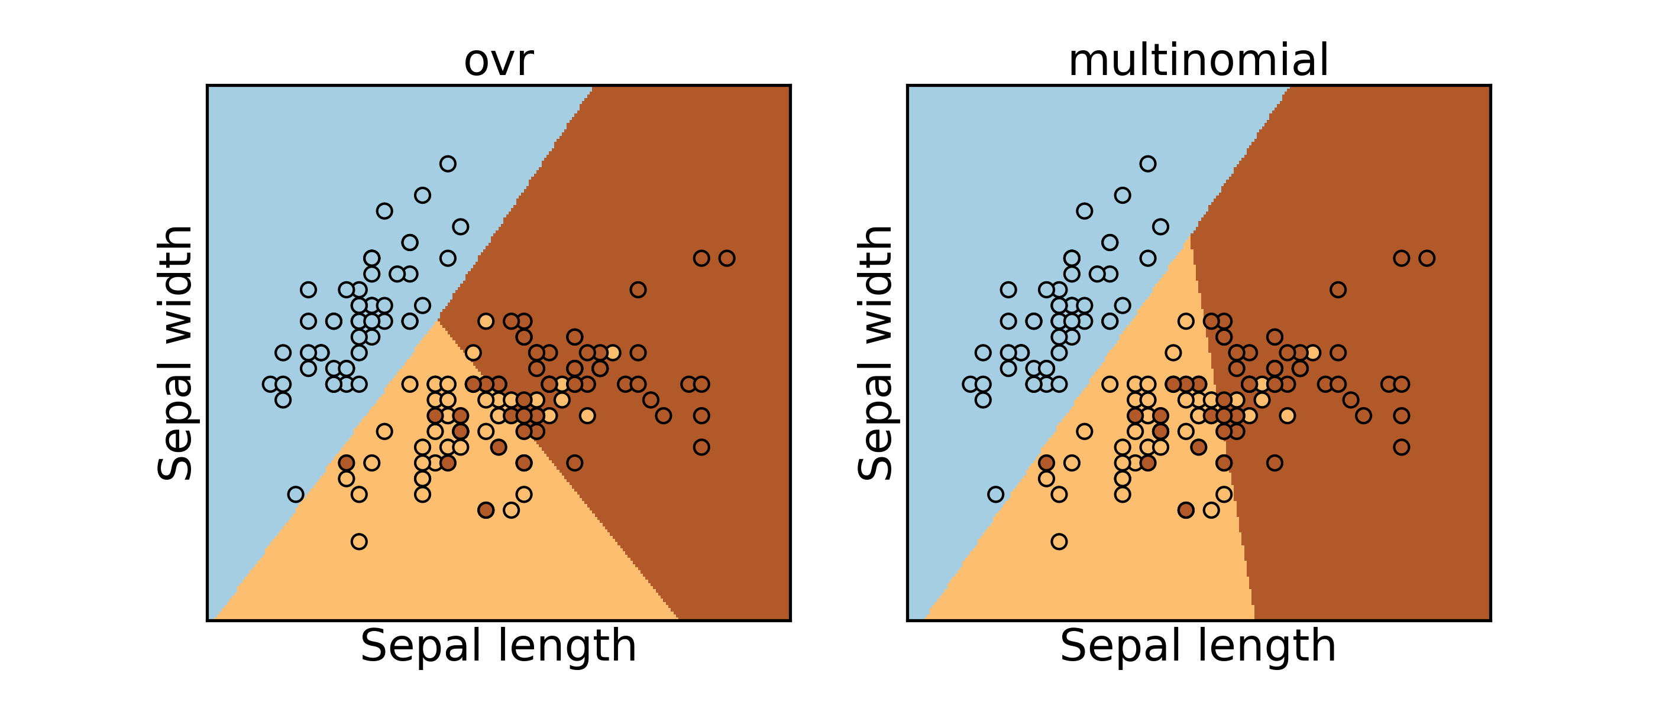
In scikit learn – multi_class parameter

Slide 69
Python Demo!

Slide 70
Deep Learning
Overview
Bonus Material
Borrowed from excellent talks by:
Adam Coates: http://ai.stanford.edu/~acoates/coates_dltutorial_2013.pptx
Fei-Fei Li and Andrej Karpathy: http://cs231n.stanford.edu/syllabus.html

Slide 71

Logistic Regression as a “Neuron”
Consider the simple function family:
“perceptron”
Neuron “fires” if weighted sum of input is greater than zero.
w₂₃x₂₃
w₅₂x₅₂
w₁₂₃x₁₂₃
Bias= w₀ x

Slide 72

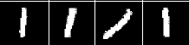
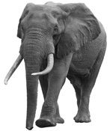

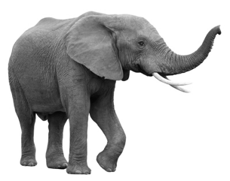
Logistic Regression: Strengths and Limitations
Widely used machine learning technique
convex → efficient to learn
easy to interpret model weights
works well given good features
Limitations:
Restricted to linear relationships → sensitive to choice of features
y = 0
y = 1
0
1
2
Pixel 2
Pixel 2
1
1
0
Pixel 1
Pixel 1

Slide 73
Feature Engineering
0
1
2
Pixel 2
Pixel 2
1
1
0
Pixel 1
Pixel 1
Rather than use raw pixels build/train feature functions:
1
=
1
(Paws, Furry)
Furry
0
0
Paws

Slide 74
Composition Linear Models and Nonlinearities
d
Input Layer
(Pixels)
W⁰
x₁
z
z
h₁
𝜎
k
=
k
k
=
k
h₂
x₂
h_{k}
1
1
1
d
x_{d}
1

Slide 75
Composition Linear Models and Nonlinearities
d
Input Layer
(Pixels)
k
W⁰
x₁
z
z
W¹
z
z
𝜎
h₁
𝜎
h₁
k
k
k
2
=
=
=
2
2
2
h₂
h₂
x₂
k
h_{k}
1
1
1
1
1
1
d
x_{d}
1

Slide 76
Neural Networks
Composing “perceptrons”
W⁰
W¹
x₁
W²
x₂
f
Input Layer
x_{d}
Hidden Layers

Slide 77
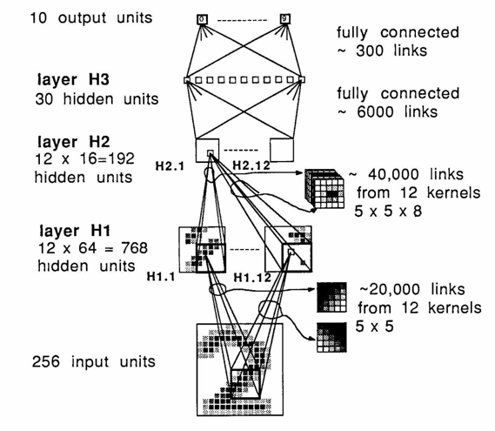
Deep Learning →Many hidden layers …
Output
Output
Input
Logistic Regression

Slide 78

Convolutional Neural Networks: Exploiting Spatial Sparsity

Slide 79
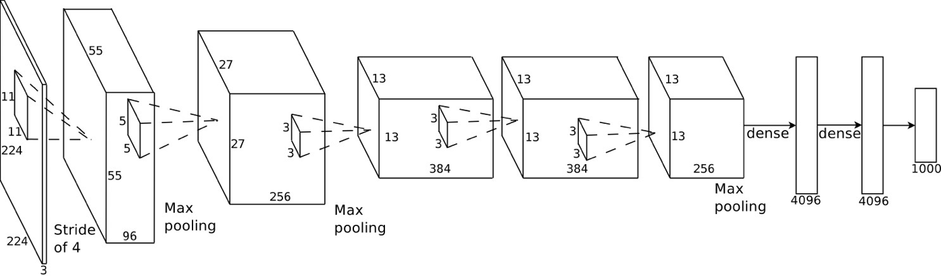
Example: AlexNet (Krizhevsky et al., NIPS 2012)
Introduced in 2012, significantly outperformed state-of-the-art (top 5 error of 16% compared to runner-up with 26% error)

Slide 80
Improvement on ImageNet Benchmark
Super Human

Slide 81
Recurrent Neural Networks: Modeling Sequence Structure
El gato en el sombrero
The cat in the hat.
input + previous output → new output
State of the art in modeling sequential data
speech recognition and machine translation

Slide 82
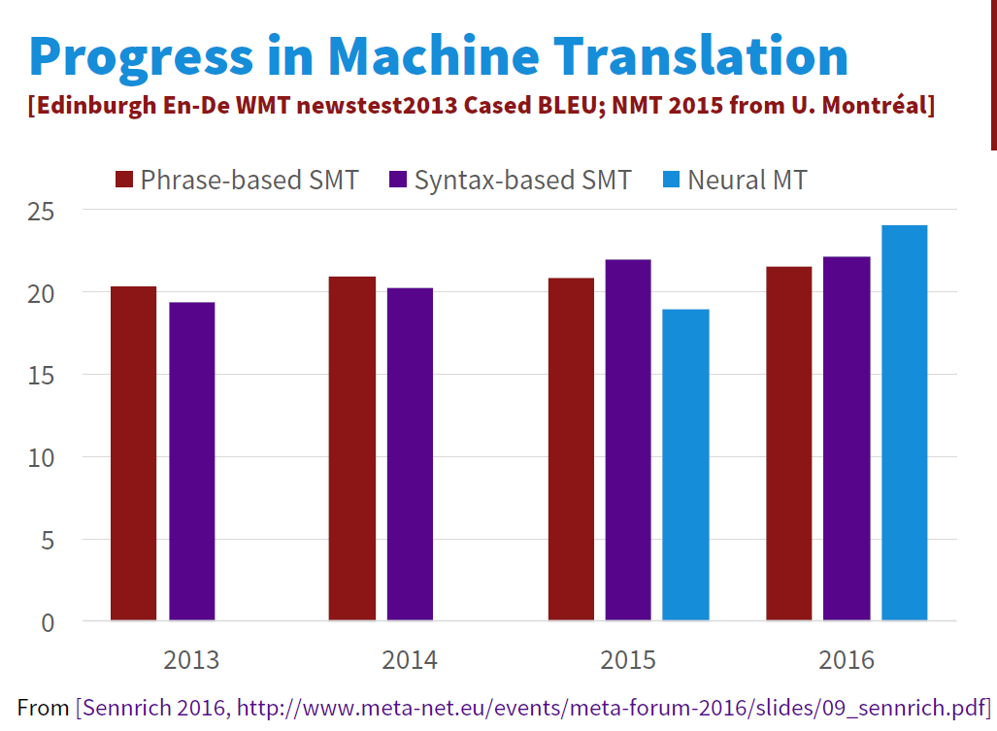
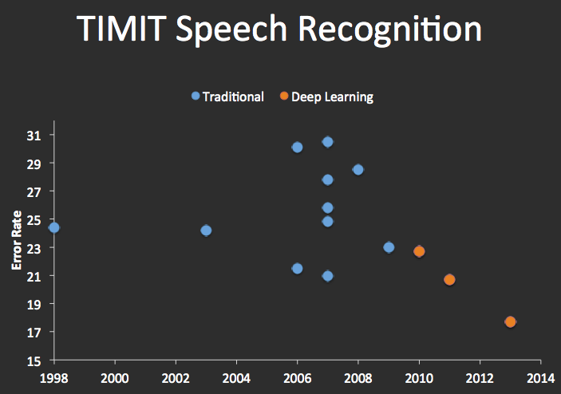
Improvements in Machine Translation & Automatic Speech Recognition

Slide 83
State of the art in Text to Speech (TTS)

Slide 84
Interested in Deep Learning?
RISE Lab Deep Learning Overview:
https://ucbrise.github.io/cs294-rise-fa16/deep_learning.html
TensorFlow Python Tutorial
Stanford CS231 Labs
http://cs231n.github.io/linear-classify/
http://cs231n.github.io/optimization-1/
http://cs231n.github.io/optimization-2/

